Slide 1
Design of door locking system using Node mcu
D.sai raghavendra --- 180040130
N.Satish --- 180040132
t. Teja --- 180040136

Slide 2
Abstract:-
Student understanding of the link between theory and application has always been a critical objective in electronics education.
Generally, we forgot to close the door during night times . Our project deals with this problem . In our project we use mainly four components , Node MCU , servo motor ,12 v Relay, solenoid lock and LDR ( light dependent resistor ) sensor .
Using these components we can resolve our problem.

Slide 3
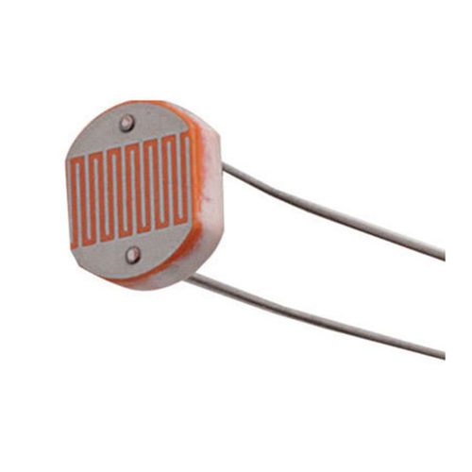
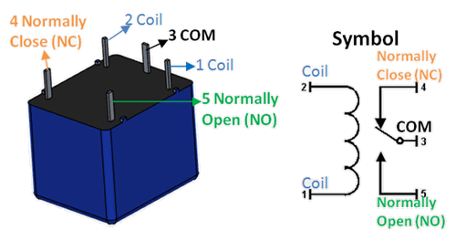
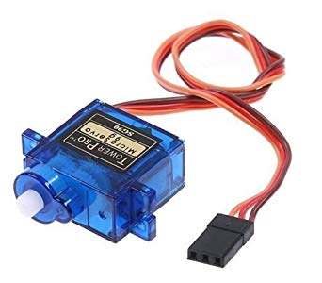
Components used:-
LDR sensor:- Relay:- Servo motor:-

Slide 4
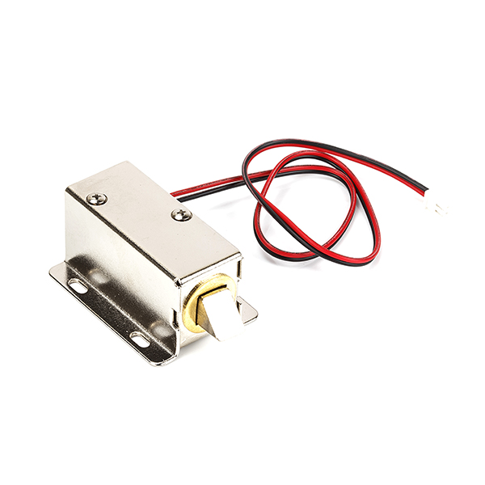
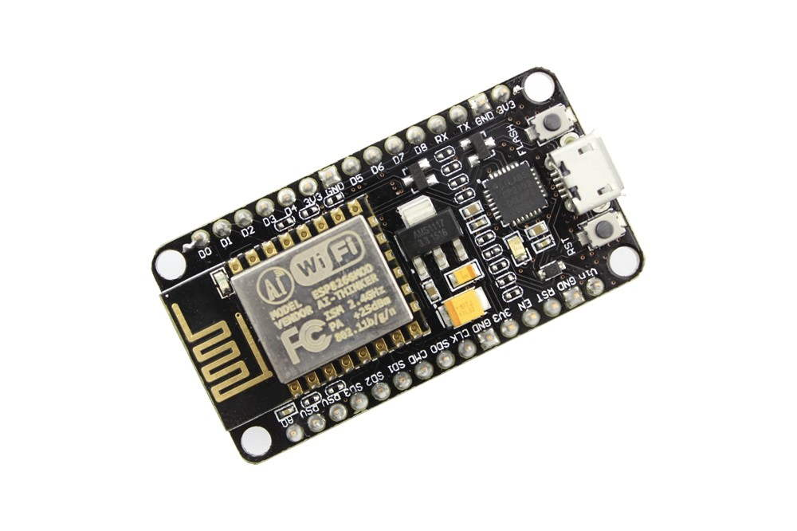
Components used:-
Solenoid lock:-
Node MCU:-

Slide 5

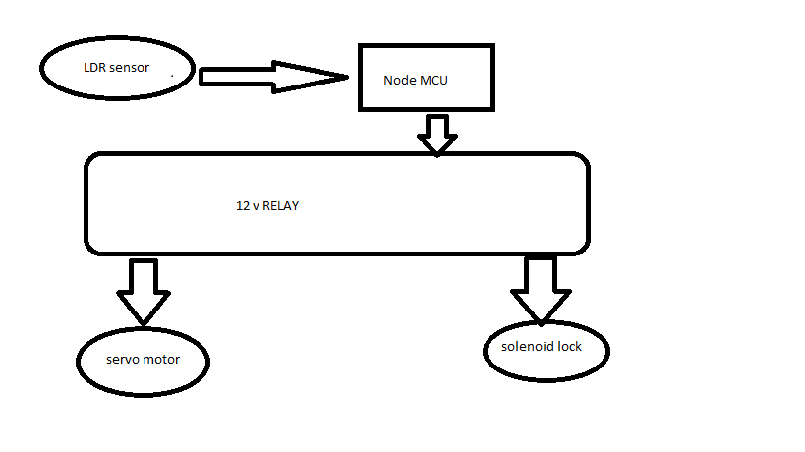
Block diagram:-

Slide 6
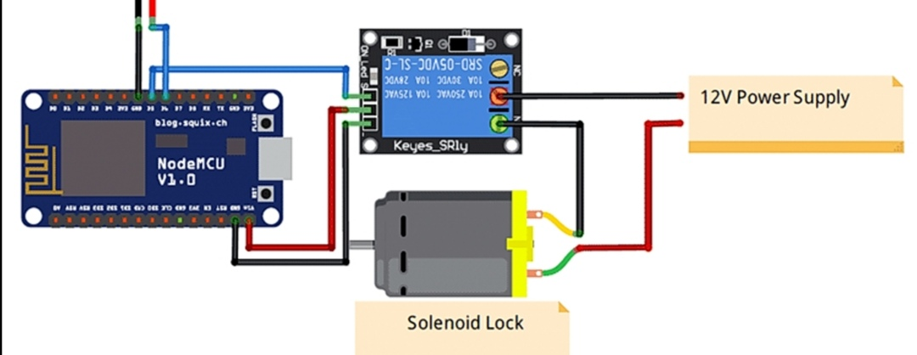
Circit diagram:-

Slide 7
Working:-
At we use LDR sensor to determine wheather it is night time or day time.
solenoid lock is for to lock the door.
servo motor is for to pull the door if the door is open.
The main electronic module is Node MCU , which is used to control the all the remaining components.
The Node MCU can able to give only 3.3 v or 5 v output supply.
we used 12 v Relay which is acts as a switch to control the solenoid lock .

Slide 8
Working:-
LDR sensor it detects the day or night time and sends to micro controller i.e., Node MCU and it analyze the input ,and executes the program.
In the program dumped in micro controller we considered certain limits , based on input it executes certain set of instructions.
if it was a night time , at first servo motor will run for some time as to pull the door , and the lock present to the door will be locked until the sensor gives the output as same as day time.

Slide 9
Advantages:-
Less cost.
Smaller size and weight.
Easy to use.
Low power consumption.
flexible.
Can increase security.

Slide 10
Disadvantages:-
Difficult to close heavy doors.
May not work properly during rainy time ( gets darker ).
Need check up atleast twice a week.

Slide 11
CONCLUSION:-
➔So we can also implement this or use in our day to day life for more safety purpose during night time.
➔Every one can afford the cost and it requires less power consumption.

Slide 12



